Slide 1
5.6 Depletion of Stratospheric Ozone

Slide 2
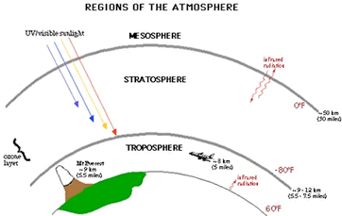

Slide 3
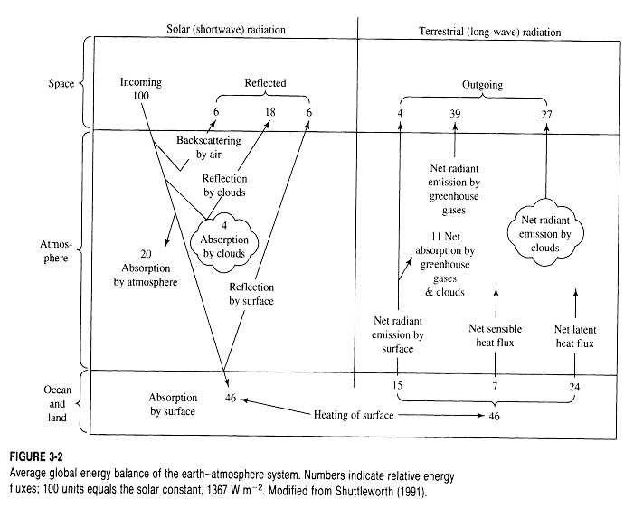

Slide 4
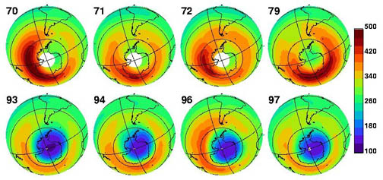
the progression of the Ozone hole over the antarctic from 1970 to 1997.

Slide 5
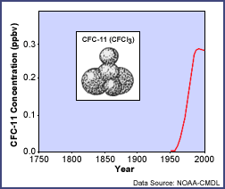

Slide 6
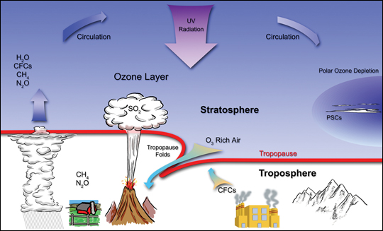

Slide 7
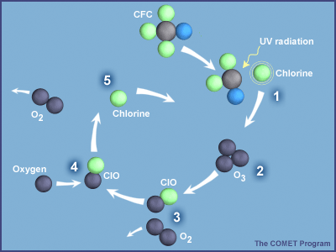

Slide 8
CFC’s can (and in some cases used to) be found in:
aerosol sprays
cleaning fluids
freezers
air conditioners
refrigerators
industrial solvents
dehumidifers
foam insulation

Slide 9
HCFC's are found in:
heat pumps
central air conditioners

Slide 10
Polar stratospheric clouds
PSCs are part of the reason why the ozone hole is greater in polar regions.
You need a recipe for this to occur.
Methane (CH4) from anaerobic digestion
CFCs from our known sources
Ozone from the breaking and bonding of oxygen.
Nitrogen Dioxide (NO2) from emissions
These react to create the inert substances of Hydrochloric Acid and Chlorine Nitrate

Slide 11
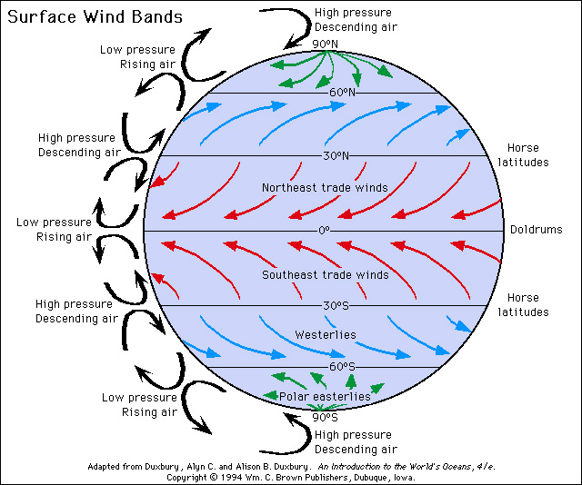
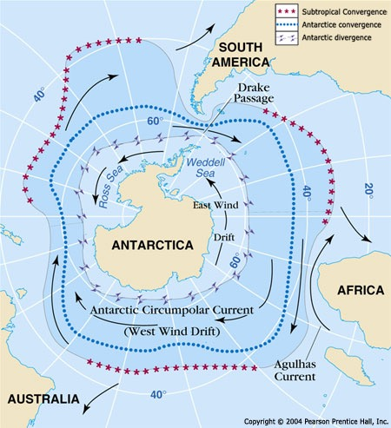
These inert substances remain trapped in the polar regions because of the atmospheric circulation patterns and rotation of the Earth.
Over time, more and more of these substances collect.

Slide 12
During the winter months when the temperatures drop below -80 degrees celsius, ice clouds form.
These clouds provide the surface for the slow reaction between HCl + ClONO2
This releases the relatively harmless Cl2 back into the atmosphere, while the Nitric Acid freezes to the cloud.
When the sun comes back out, the Cl2 disassociates into 2 x Cl, attacking the O3

Slide 13
Some effects on plant and animal tissue as UV radiation increases
decrease in agricultural yields and a decrease in overall forest productivity
cellular/DNA damage to fish larvae, plankton and other organisms at the bottom of food webs thus affecting all higher trophic levels in the food web.
Increase in the rate of skin cancer (a decrease in 1% in the ozone layer is predicted to increase skin cancers by 10%.)
Increase in Xeroderma pigmentosum
Increase in cataracts and changes in the retina, in mammals. Sheep and cattle in Argentina and Chile are already suffering from this effect.
Suppresses and depresses the immune systems in mammals.

Slide 14
Brief history and status at this point in time:
1978- U.S. banned CFC's as propellants in aerosol products
1985 British Antarctic Expedition reports holes in the Ozone layer
1987- "Montreal Protocol on Substances that deplete the Ozone Layer"
1990 - London protocol - International conference to control these chemicals. Signed by U.S. and 22 other countries. Limited production and use of CFC's
50% reduction in CFC production worldwide by 2000
Now signed by over 90 nations
Revised to require the virtual phaseout of CFC production by 1996

Slide 15
Alternatives and replacements for CFC’s with pros and cons.
HCFCs (hydrochloroflurocarbons)
Positive aspect -break down more quickly in the atmosphere posing less danger to the ozone layer
Negative aspect -if overused they could cause damage to the ozone layer in the same way as CFC’s. Redesigned appliances could use more energy than the original models.
HFCs (hydrofluorocarbons)
Positive aspect-do not contain chlorine and are therefore safe for the ozone layer
Negative aspect -safety questions such as flammability and toxicity still unclear
Hydrocarbons (such as butane and propane)
Positive aspect – they are relatively cheap and readily available
Negative aspect -can be flammable and poisonous and some increase ground-level pollution
Ammonia
Positive aspect -a simple alternative for refrigerators
Negative aspect -must be handled carefully
Water (and Steam)
Positive aspect -effective for some cleaning applications

