Slide 1
Ozone formation in the troposphere

Slide 2
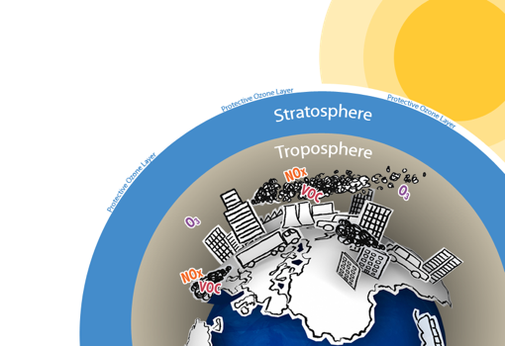
Remember…
Ozone is Good Up High and Bad Nearby
3
3

Slide 3
Los Angeles, CA
Too much ozone here…
Cars, trucks, power plants and industry all emit air pollution that forms ground-level ozone.
Ozone is a primary component of smog.

Slide 4
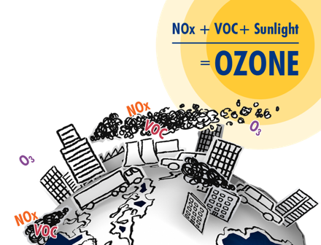
Ground level or “bad” ozone is not emitted directly into the atmosphere, but is created by chemical reactions of oxides of nitrogen (NOx) and volatile organic compounds (VOC) in the presence of sunlight.

Slide 5
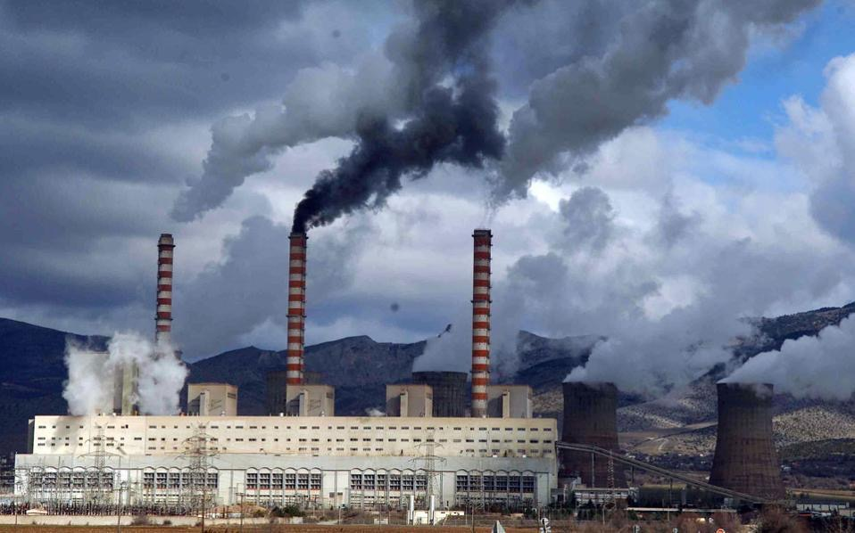
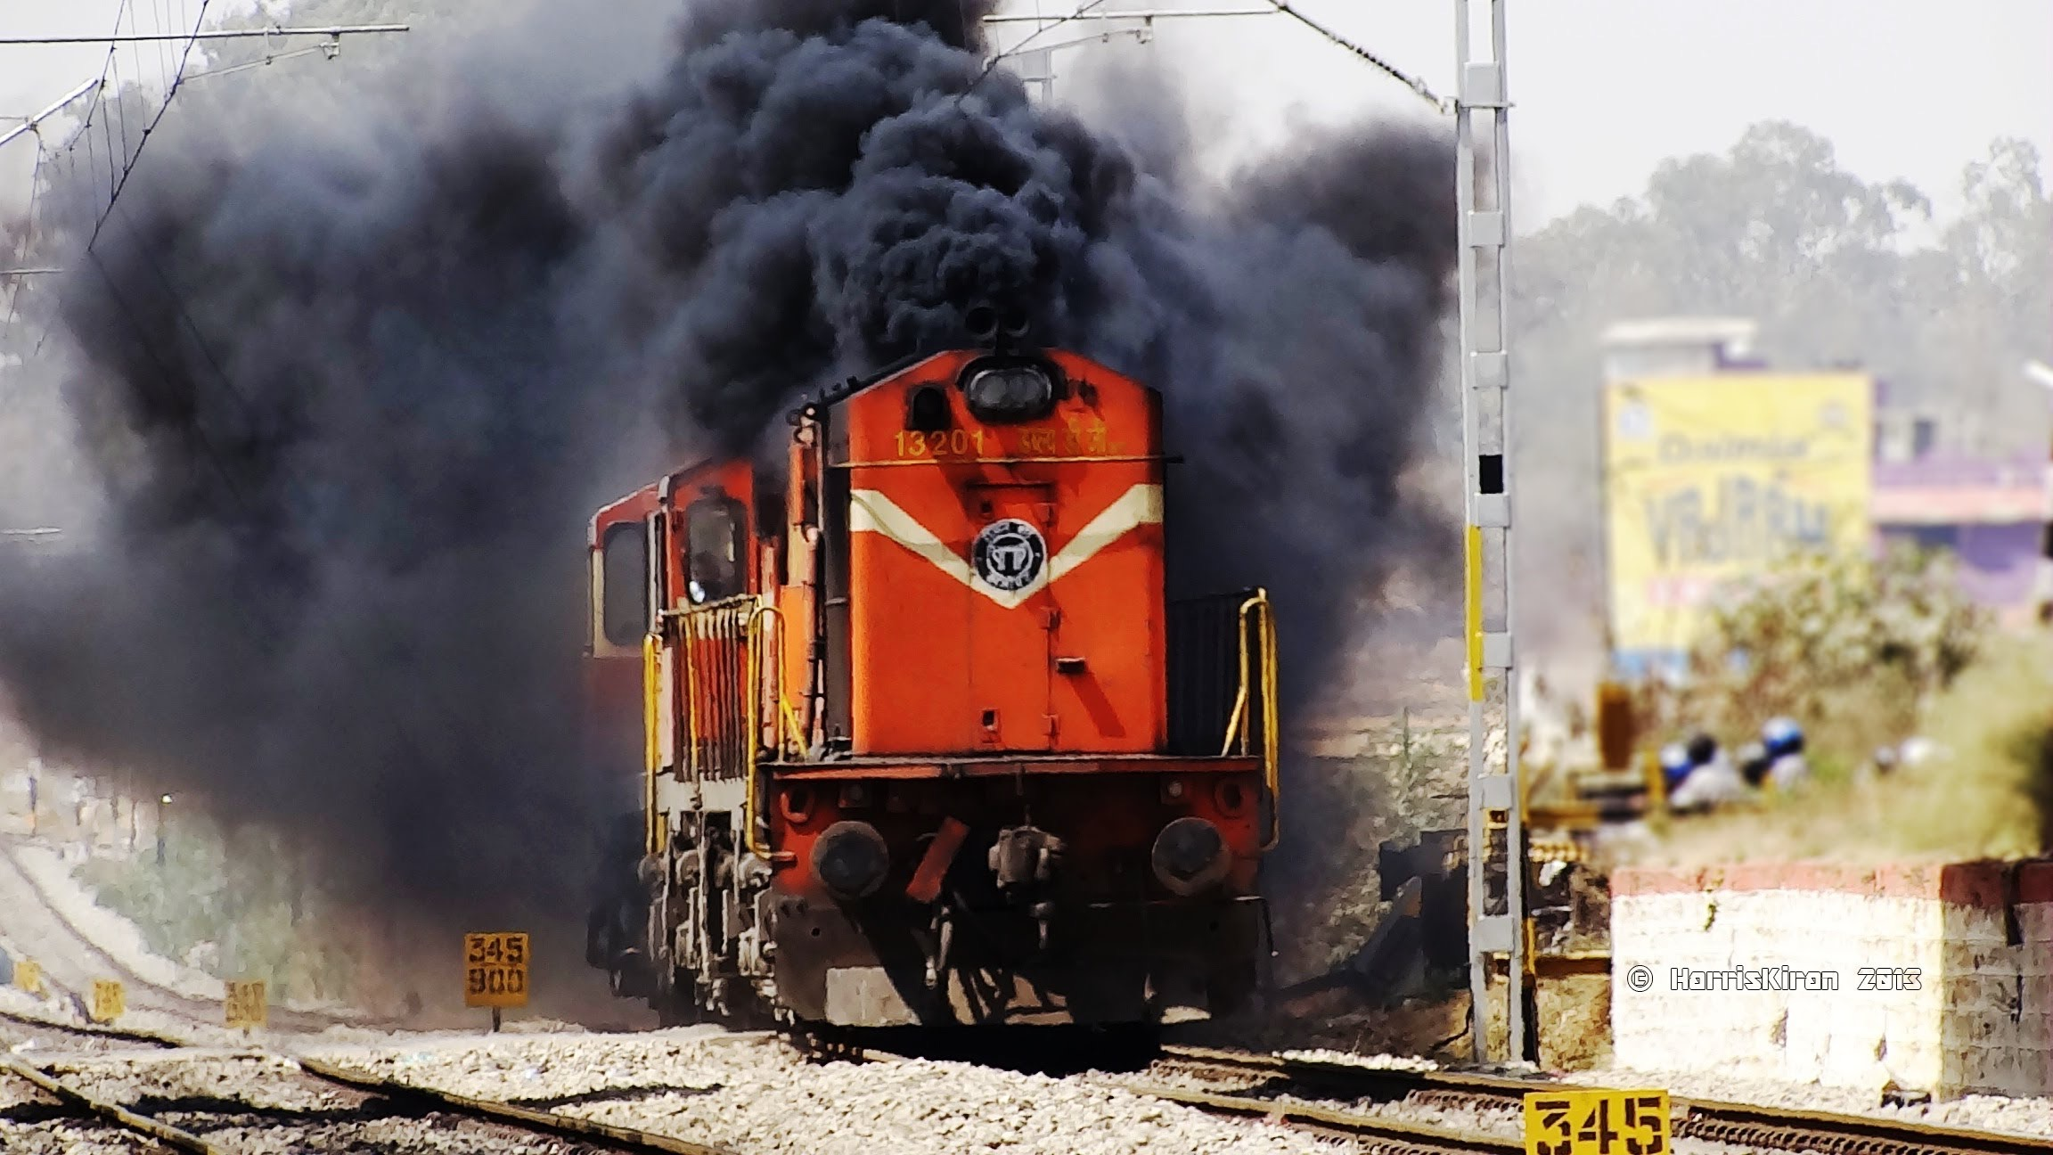
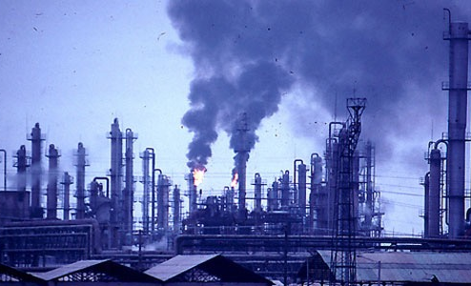
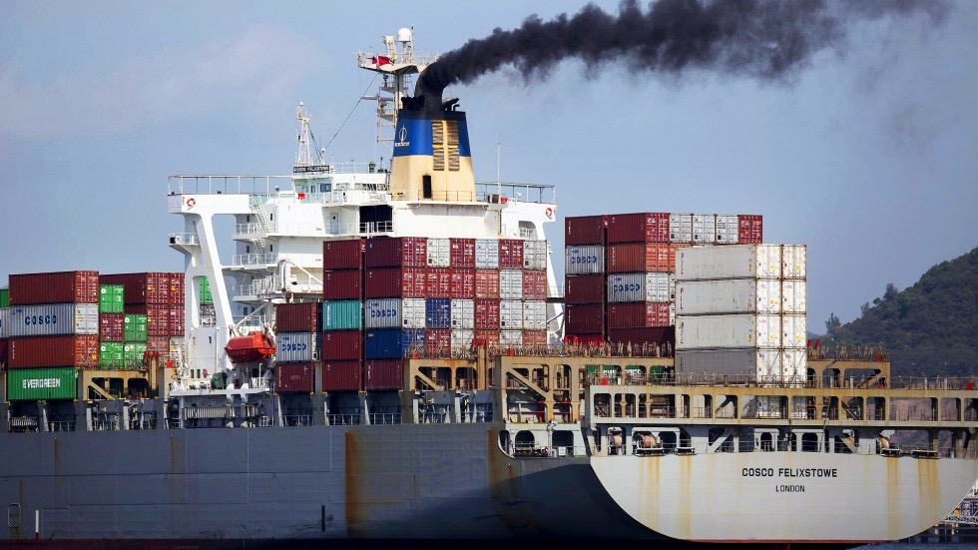

Slide 6
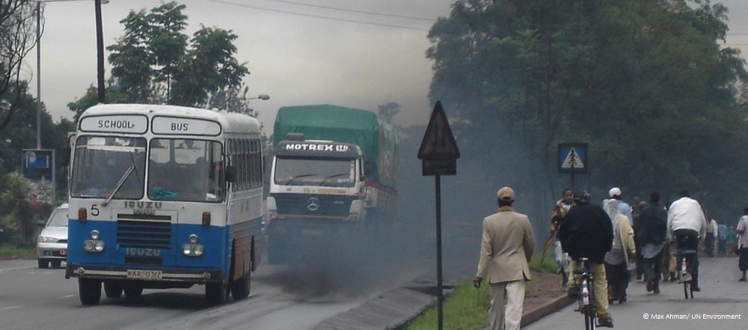
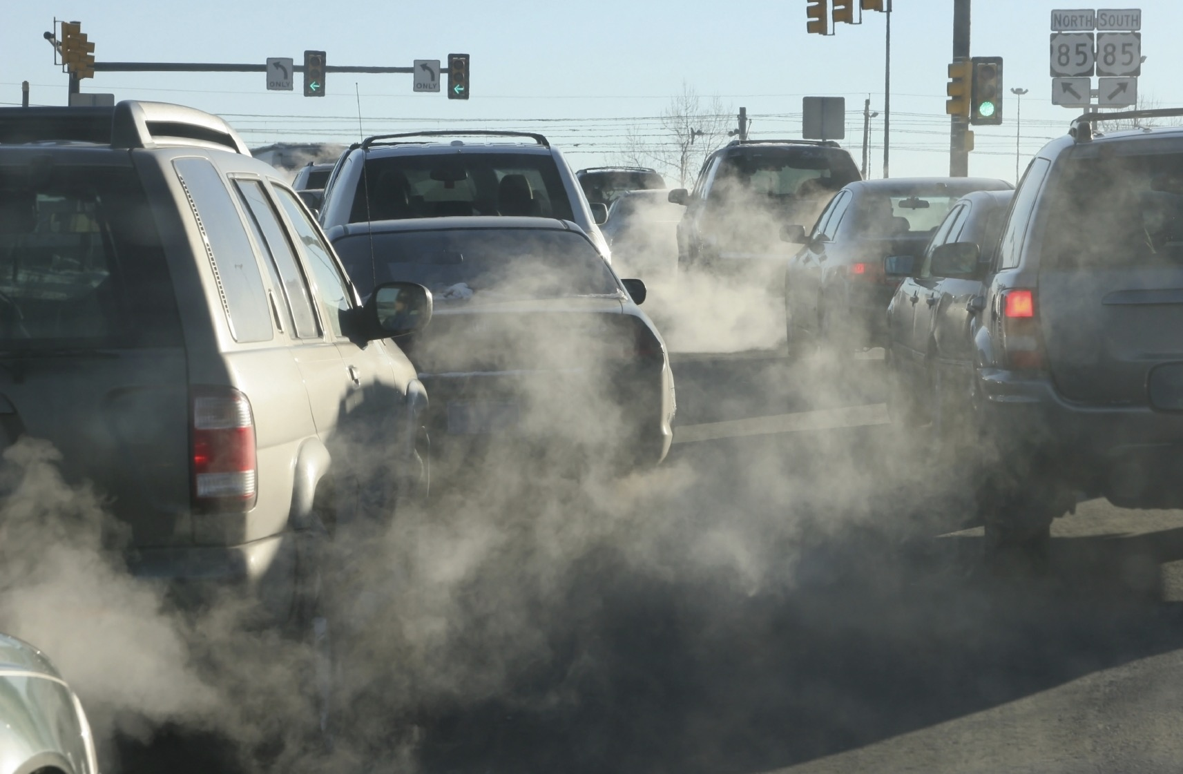

Slide 7
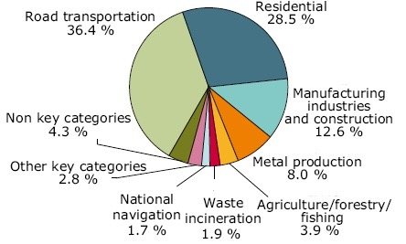
2005 EU-27 Sources of Nitrogen Oxides

Slide 8
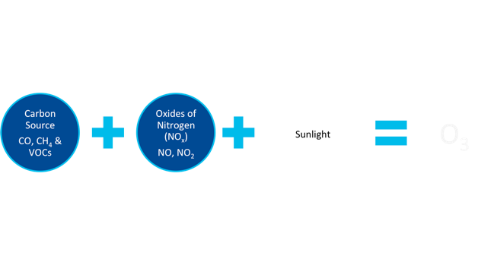
ozone precursors

Slide 9
The series of reactions with CO that leads to the formation of ground level ozone:
In step four you see the need for sunlight to break the nitrogen dioxide apart.
CO + OH → CO₂ + H
H + O₂ → HO₂
HO₂ + NO → OH + NO₂
NO₂ + hv → NO + O
O + O₂ → O₃
Sunlight
N
O
O
N
O
A single Oxygen atom (O) in the atmosphere will quickly find an O2 and bind with it to form Ozone (O3).
O
+
O₂
O₃
=

Slide 10
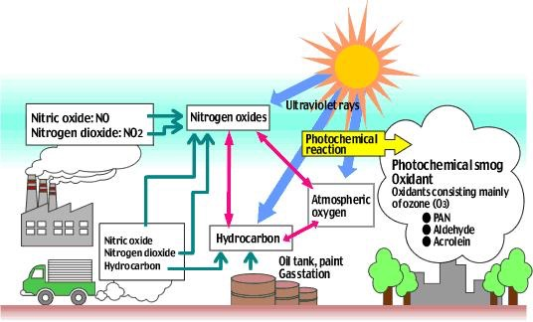
The easiest way to understand how primary and secondary pollutants mix.

Slide 11
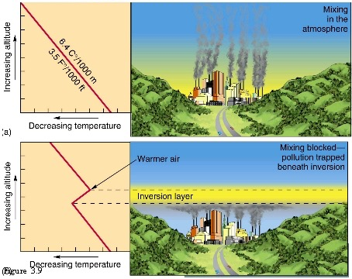

Slide 12
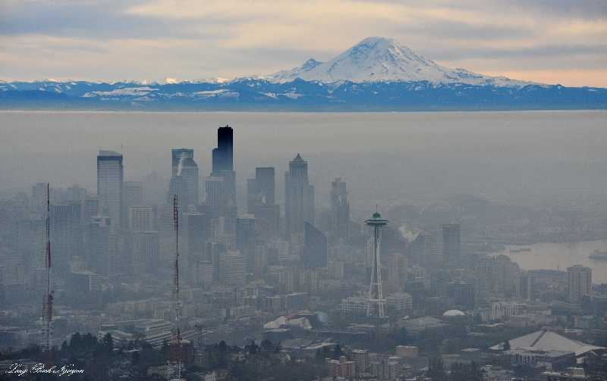

Slide 13
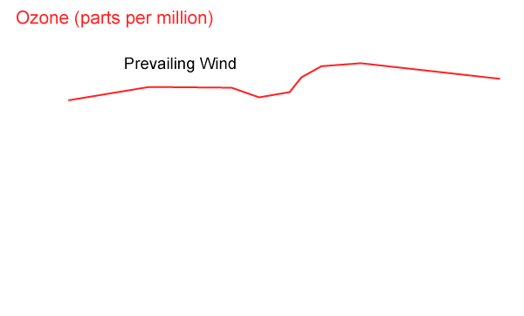
Rural areas can suffer from high ozone that is transported by the wind from large cities. It can also take time for ozone to form, so a city might not see much ozone, but the town downwind of it will see the highest concentrations. This also depends on geographical situation.

Slide 14
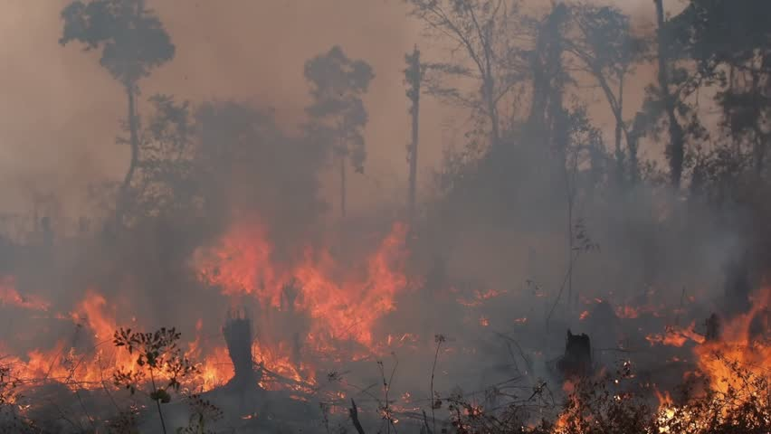
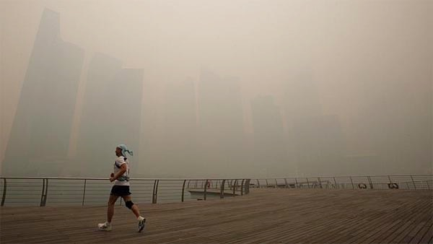
Deforestation and burning

Slide 15
Ozone concentration in the air is not significantly decreased by rain itself, but can be decreased due to its partner – clouds. The clouds cover the sun and reduce the amount of sunlight needed to form ozone.
Unlike Ozone, SO2 and NO2 are soluble in water and react with rain drops to form Sulfuric and Nitric Acid, which is better known as acid rain.
Rain
=
Clouds
=
Less Sunlight & UV Rays
=
Less Ozone

Slide 16
Effects on forests and Crops
Interferes with the ability of plants to produce and store food
Damages the leaves of trees and other plants, harming the appearance of vegetation in urban areas, national parks and recreational areas
Increased susceptibility to disease and insects
Effects on materials
Rubber, fibers, and certain paints may be damaged by exposure to ozone. Some elastic materials can become brittle and crack (take a look at old rubber bands!), while paints and fabric dyes may fade more quickly.

Slide 17
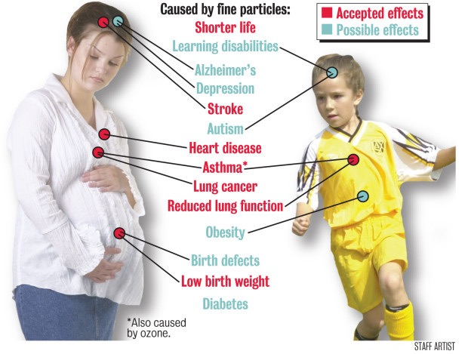
Human impacts
airway irritation, coughing, and pain when taking a deep breath;
wheezing and breathing difficulties during exercise or outdoor activities;
inflammation, which is much like a sunburn on the skin;
aggravation of asthma and increased susceptibility to respiratory illnesses like pneumonia and bronchitis; and,
permanent lung damage with repeated exposures.

